Slide 1
CyberGraph Intelligence Platform
P R O J E C T T I T L E
ES3701 - Project Phase I
Presenting By
Team Member 1 Name Team Member 1 Regd No. Team Member 1 Section Team Member 2 Name Team Member 2 Regd No. Team Member 2 Section Name of the Guide
: Naveen S
: 23AD086
: A
: Hari krishnan S
: 23AD048
: A

Slide 2

Problem Statement
Security analysts today must piece together threat intelligence from multiple disconnected sources — vulnerability databases (like NVD), adversary behavior catalogs (like MITRE ATT&CK), and exploit feeds — each stored as flat, siloed data with no inherent relationships between them. Answering a realistic security question, such as "which of our systems are exposed to techniques used by a specific threat actor," requires manually cross-referencing several of these sources by hand, which is slow, error-prone, and doesn't scale as new vulnerabilities and threat actors emerge daily.
Furthermore, existing tools are largely reactive — they answer questions only when an analyst explicitly asks them, and provide no way to continuously monitor whether an organization's specific software is affected by newly disclosed vulnerabilities or targeted by active threat campaigns, leaving analysts dependent on manually checking for updates rather than being proactively notified.

Slide 3
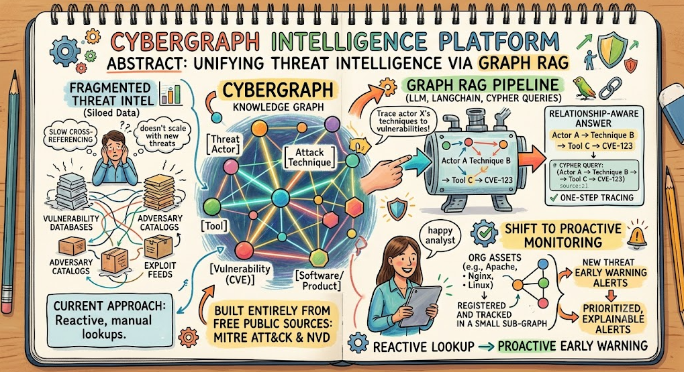
Abstract
Security analysts today rely on fragmented threat intelligence — CVE databases, adversary behavior catalogs, and exploit feeds — stored as disconnected data, making questions like "which systems are exposed to a specific threat actor's techniques" slow and manual to answer.
CyberGraph Intelligence Platform solves this by modeling threat actors, attack techniques, and CVEs as a connected Neo4j knowledge graph, built from free public sources — MITRE ATT&CK and the National Vulnerability Database. A Graph RAG pipeline (LangChain + LLM-generated Cypher) lets analysts ask natural-language questions and get relationship-aware answers — tracing an actor to their tools to the exact vulnerabilities exploited — via a FastAPI backend and React UI, with threat actor profiling and CVE lookup built in. The platform is further being extended with proactive asset monitoring, alerting analysts the moment a new threat affects software their organization specifically depends on.

Slide 4
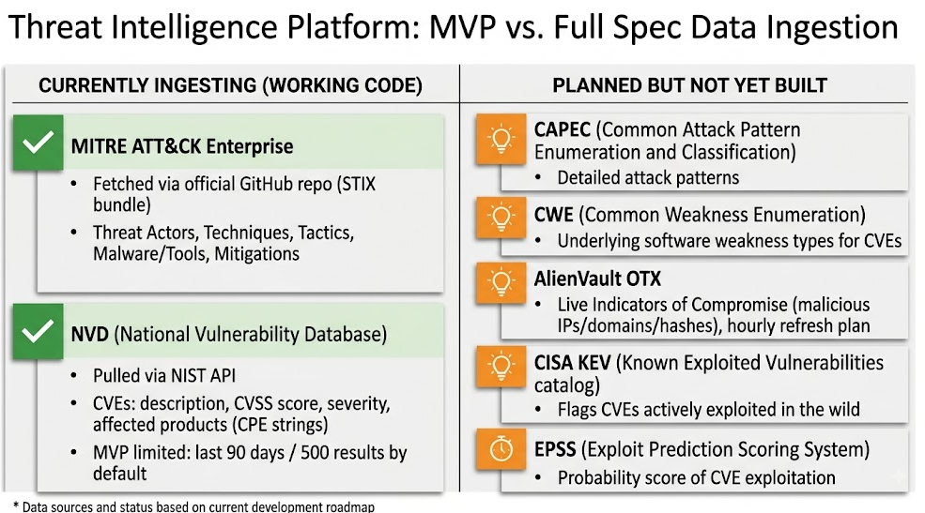
Data collection and analysis

Slide 5
Methodology and System Design
1. Graph-Centric Modeling
Represent the cybersecurity domain — threat actors, CVEs, malware, attack techniques — as an interconnected Neo4j knowledge graph, instead of flat, siloed data tables.
2. Retrieval-Augmented Reasoning (Graph RAG)
Combine LLM-generated Cypher graph traversal with natural-language question answering, enabling multi-hop, relationship-aware reasoning rather than isolated fact lookup.
3. Modular, Phased Implementation
Build ingestion → graph storage → RAG reasoning engine first, then layer intelligence modules (actor profiling, CVE lookup, and — in progress — proactive asset monitoring) on top, enabling iterative development and testing.

Slide 6
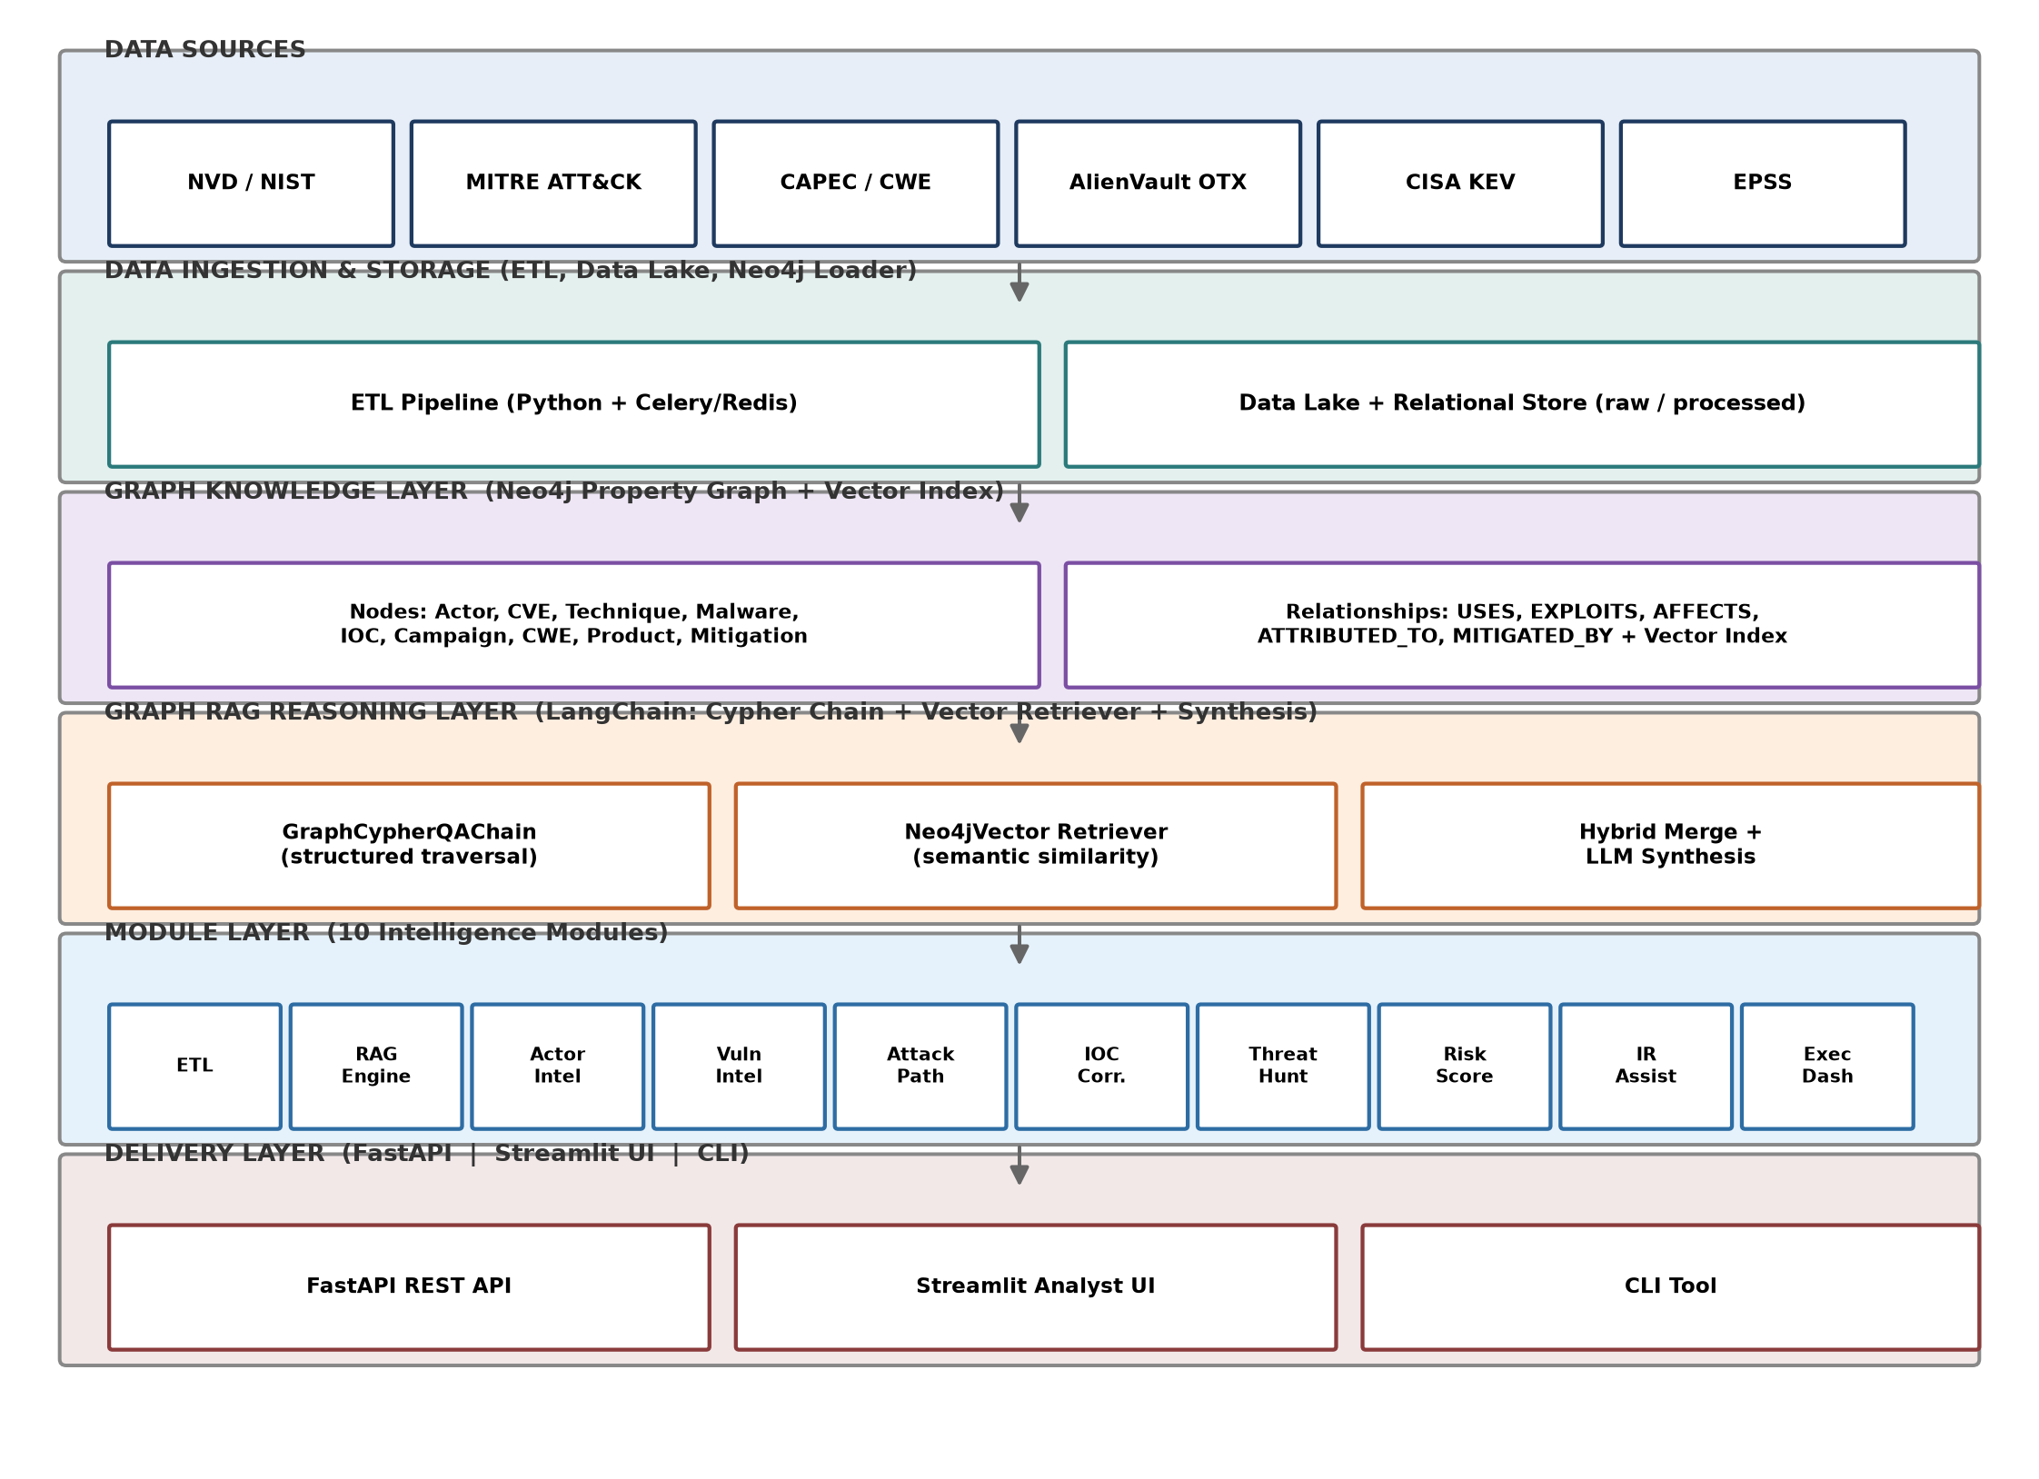

SYSTEM DESIGN ARCHITECTURE

Slide 7
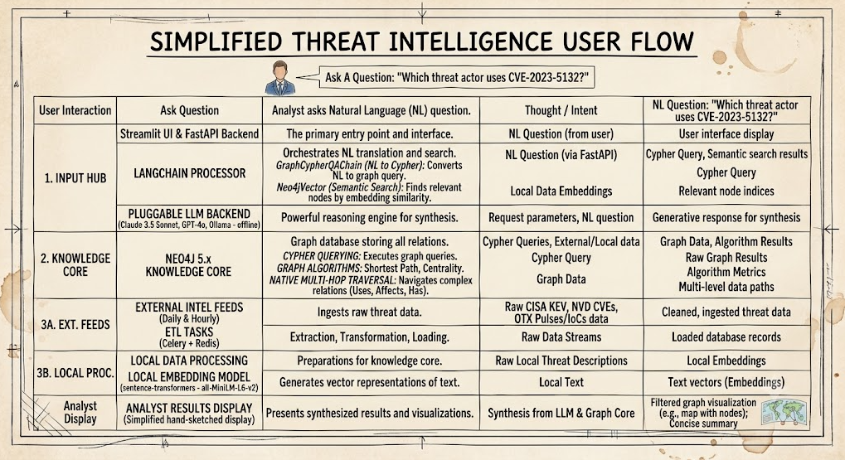
TECH STACKS

Slide 8
WORK TO BE DONE
1. Remaining Data Sources
CAPEC & CWE ingestion (attack patterns and root-cause weakness types)
AlienVault OTX (live IOC feed — malicious IPs/domains/hashes)
CISA KEV enrichment (flag actively-exploited CVEs)
EPSS scoring (exploit-likelihood prediction)
4. Remaining Intelligence Modules
Attack path analysis, IOC correlation, threat hunting, risk scoring,
incident response assistant, executive dashboard
(Modules 3–10 from the original spec)
2. Retrieval Upgrade
Vector/embedding-based semantic search (currently Cypher-only retrieval)
Hybrid retriever merging structured + semantic results
5. New Feature — Proactive Asset Monitoring
Let analysts register their organization's specific software
Auto-alert when a new CVE/threat affects it, with priority scoring and a "how to fix" explanation
Offline LLM fallback (Ollama) for air-gapped operation
3. Automation
Celery + Redis scheduler for automatic, periodic data ingestion
(currently manual)

Slide 9
References
MITRE Corporation. (2024). MITRE ATT&CK®: A knowledge base of adversary tactics and techniques. Retrieved from https://attack.mitre.org
National Institute of Standards and Technology (NIST). (2024). National Vulnerability Database (NVD). Retrieved from https://nvd.nist.gov
Cybersecurity and Infrastructure Security Agency (CISA). (2024). Known Exploited Vulnerabilities (KEV) Catalog. Retrieved from https://www.cisa.gov/known-exploited-vulnerabilities-catalog
Edge, P., C LangChain Contributors. (2024). LangChain: Building applications with LLMs through composability [Software documentation]. Retrieved from https://python.langchain.com
Neo4j, Inc. (2024). Neo4j Graph Data Science and GraphRAG documentation. Retrieved from https://neo4j.com/docs

Slide 10
Thank You!

